Slide 1

DBMS PROJECT
SUPERMARKET DATABASE
PRESENTED BY:
21CSB0B25
K.SIDDHARDH
21CSB0B63
V K ASHISH

Slide 2
PROBLEM STATEMENT SUPERMARKET DATABASE
The motive of this project is to design a data base for a supermarket chain that has its branches in many cities it sells all the essentials, groceries etc. The data base maintains the record for the employees, suppliers of each store and the billing and payment details of the customers and the discounts offered to them based on the purchasing quantity.

Slide 3
CONTENTS
ER-DIAGRAM
RELATIONAL SCHEMA
DATA BASE DESCRIPTION
RELATIONS IN THE NORMALISED FORM
QUERIES

Slide 4
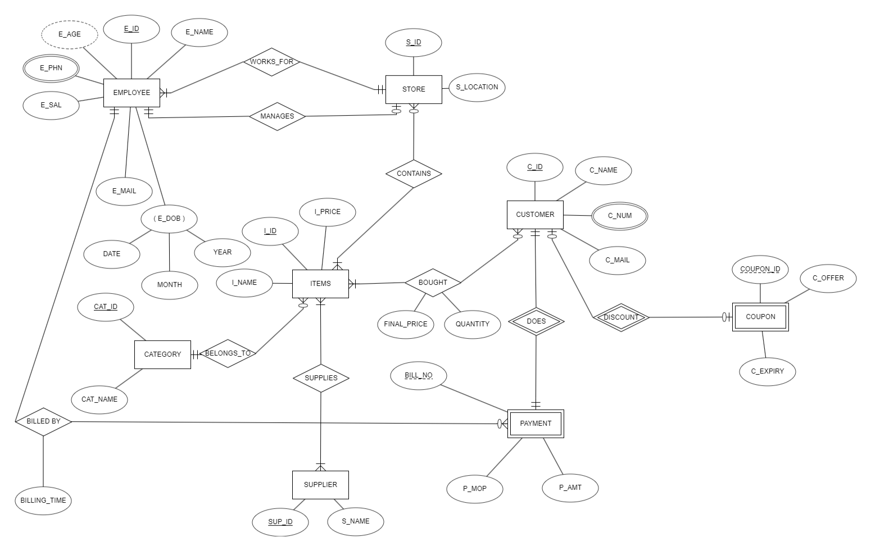
ER-DIAGRAM

Slide 5
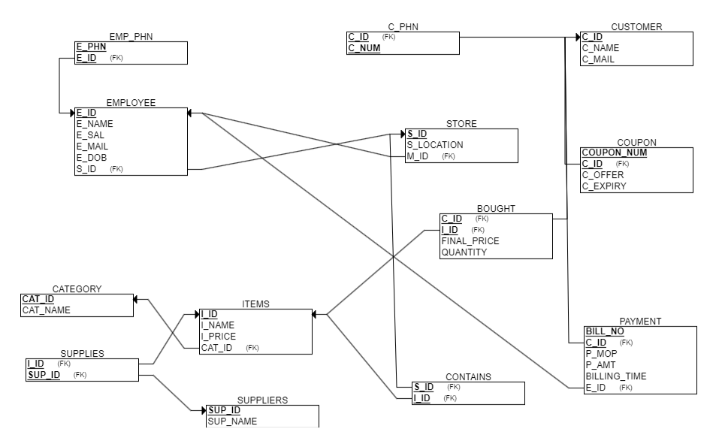
RELATIONAL SCHEMA

Slide 6
DESCRIPTION OF THE DATABASE
The data base consists many relations that consists the data of the sales, supplies, stocks and payment details of the supermarket.
The relation employee, customer consists the details of the employees and customers like name, mail, age ..of all the stores of the supermarket. E_id,C_id are the primary keys of employee and customer relations respectively.
The relations emp_phn and c_phn consists of the phone numbers of the employees and customers respectively.
The relation store holds the information about the details of the different stores at different locations belonging to the supermarket with their manager details. It includes manager id ,store id ,store location as its attributes. Store id (s_id) is the primary key of the relation.
The relation items contains the list of unique items that are present across different stores of the supermarket chain. It includes id and name and price of the item. Item id (I_id) is the primary key of the relation.
The relation contains maps the stores with the items present in the items relation with item_id and store_id as its attributes.

Slide 7
DESCRIPTION OF THE DATABASE
The relation category lists all the categories to which the items in the item relation belongs to. It consists of category_id and category_name as its attributes with category id (cat_id) as its primary key.
The relation supplier details consists the details of all the suppliers like supplier_id , supplier_name that supplies the items to all the stores of the supermarket with supplier id (s_id) as its primary key.
The relationship supplies shows the info of the items that are supplied by each supplier relating the items and supplier tables. It consists item_id and supplier_id as its attributes with both combined produces the primary key of the relation.
The relation bought contains the information about the items that are bought by each customer .Customer_id , item_id , finalprice and quantity are the attributes to this relation.Customer_id, item_id (c_id,i_id) as a pair forms the primary key.
The relation coupon consists of different kinds coupons that provide discount to the customers who have the coupon it is paired with each customer and the discounts are given. It consists coupon_offer, coupon_expiry date as its attributes.
The relation payment consists of the payment details like the mode of payment , payment amount and bill number and the billing info like billing time, billing employee and the customer id who did the payment. Customer_id, bill number (c_id,bill_no) as pair forms the primary key of the relation.

Slide 8
NORMALISTION
All the relations in the schema are in normalised form till BCNF. With no partial dependency, transitive dependency and the primary key of each table determining all the attributes of the relation.
All the relations are in 1NF, 2NF ,3NF ,BCNF.

Slide 9
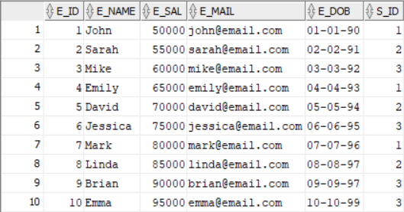
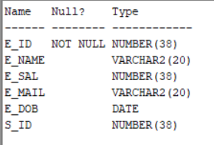
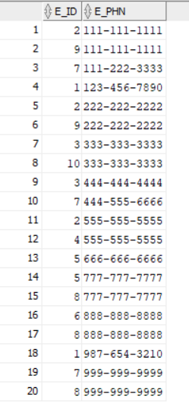

RELATIONS
EMPLOYEE:
EMP_PHN

Slide 10
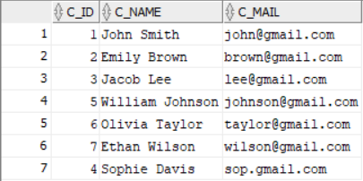
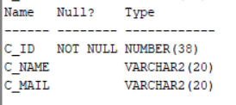
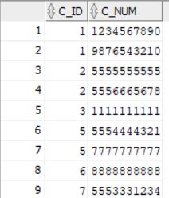
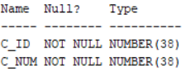
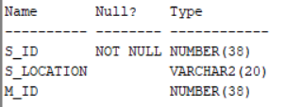
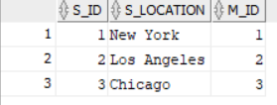
CUSTOMER
C_PHN
STORE

Slide 11
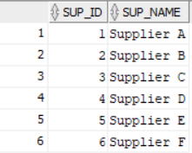

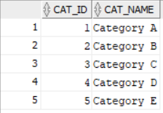

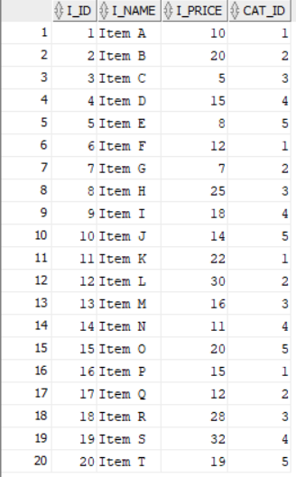
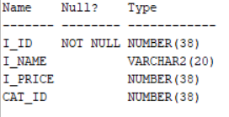
SUPPLIERS:
CATEGORY
ITEMS

Slide 12
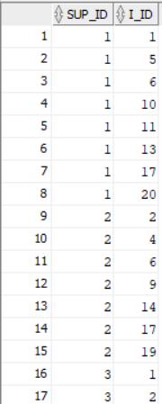
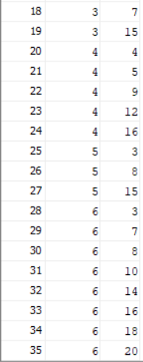

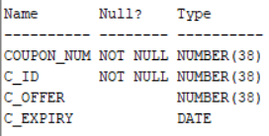
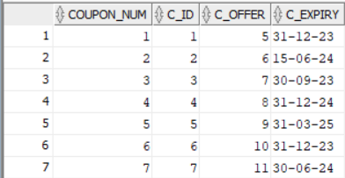
SUPPLIES:
COUPON:

Slide 13
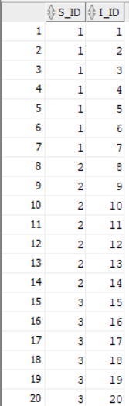
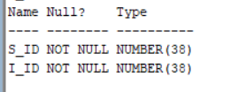
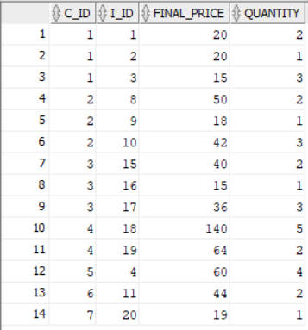
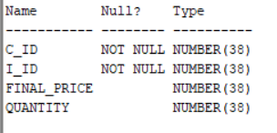
CONTAINS:
BOUGHT:

Slide 14
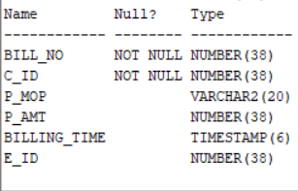
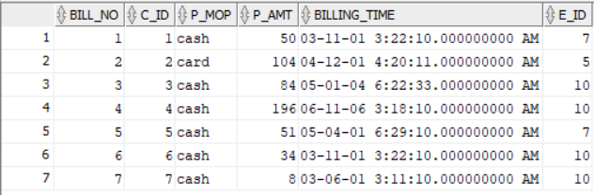
PAYMENT:

Slide 15

QUERIES
Q1 Write a query to find the revenue of store with store id 1.
Query:
select sum(p_amt) as revenue from payment natural join (select distinct s_id,c_id from store natural join (select * from bought natural join contains)where s_id=1)x ;

Slide 16

Q2 write a query to find the supplier names whose supplied items are bought by customer 3.
Query:
select sup_name from suppliers
natural join
(select distinct sup_id from supplies natural join
(select c_id,i_id from bought where c_id=3)x
)y ;

Slide 17


Q3 Write a query to select the phone number of the employee who billed the purchases of customers who went to store 1
Query:
select E_phn from EMP_phn where e_id in ( select e_id from payment where (c_id,3) in ( select distinct s_id,c_id from store natural join (select * from bought natural join contains)));
Q4 Write a query to select the name of the employee who billed the maximum number of transactions;
Query:
select e_name from employee natural join(
select e_id from(
select e_id,count(*) as no_of_billed from
(select e_id from payment)
group by e_id
order by no_of_billed desc)x
fetch first 1 row only)y;

Slide 18

Q5 list the name of the manager of store with max revenue;
Query:
select e_name from employee where e_id in(
select m_id from store where s_id in(
select s_id
from
(select c_id,sum(p_amt)as total from payment group by c_id)
natural join
(select distinct s_id,c_id from store natural join (select * from bought natural join contains))
order by total desc
fetch first 1 row only));

Slide 19


